Slide 1
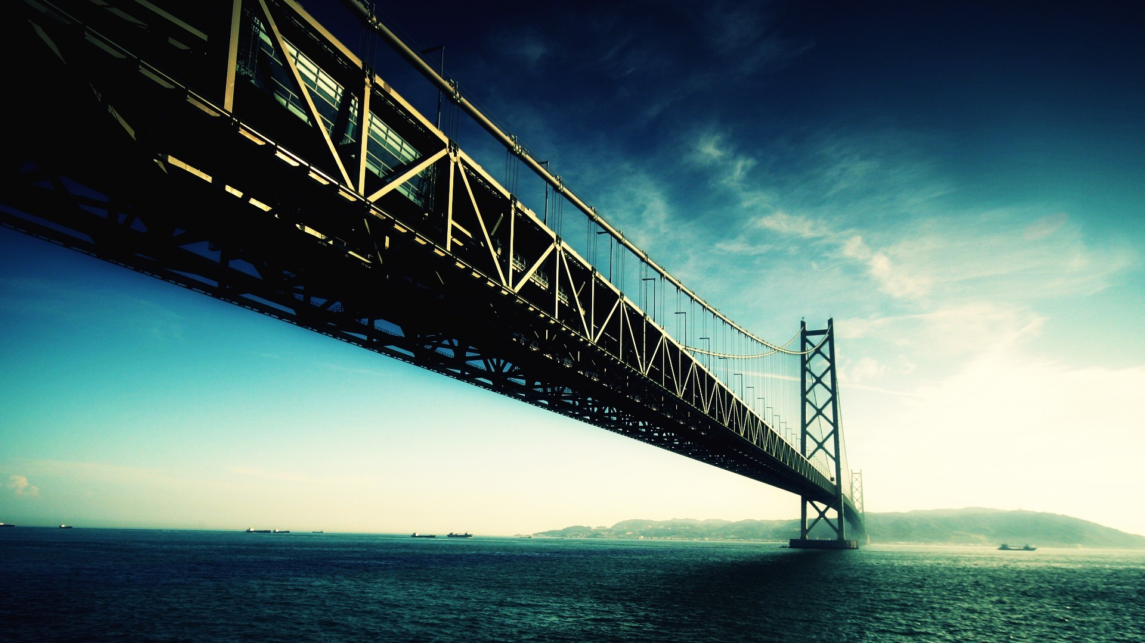
INTERDISCIPLINARY PROJECT
ORESUND
BRIDGE

Slide 2
GROUP MEMBERS
Name | Roll Number
Aman Jeet | 111060
Sanat Pawar | 111077
Sugandh Kedia | 111073
Shreerang Mathree | 111056

Slide 3
01
INTRODUCTION
02
HISTORY
INDEX
03
CONTENTS
ROLE OF ENGINEERS
04
ENVIRONMENTAL ISSUES
05
CONCLUSION

Slide 4
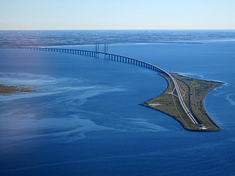
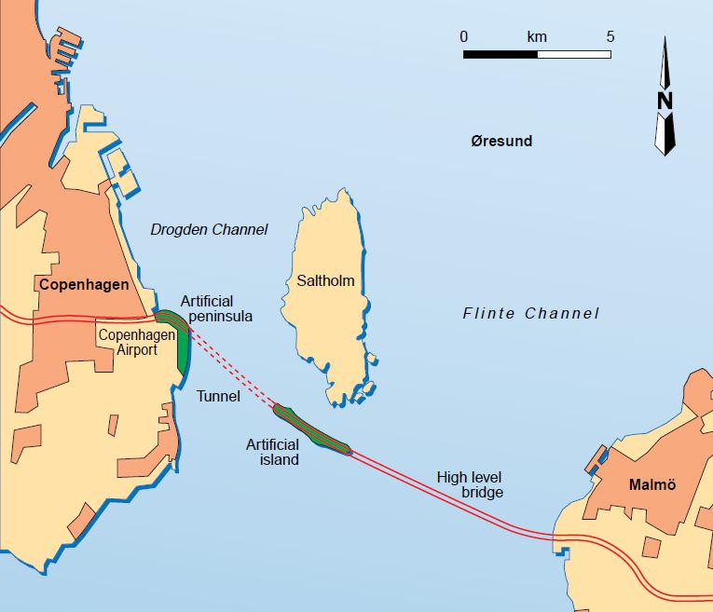
INTRODUCTION
The Öresund or Øresund Bridge is a combined railway and motorway bridge across the Øresund strait between Denmark and Sweden. It is the longest combined road and rail bridge in Europe, running nearly 8 kilometres from the Swedish coast to the artificial island Peberholm in the middle of the strait. The crossing is completed by the 4-kilometre Drogden Tunnel from Peberholm to the Danish island of Amager.
The bridge connects the road and rail networks of the Scandinavian Peninsula with those of Central and Western Europe. A data cable also makes the bridge the backbone of Internet data transmission between central Europe and Sweden. The bridge was designed by Jorgen Nissen and Klaus Falbe Hansen from Ove Arup and Partners, and Niels Gimsing and Georg Rotne.

Slide 5
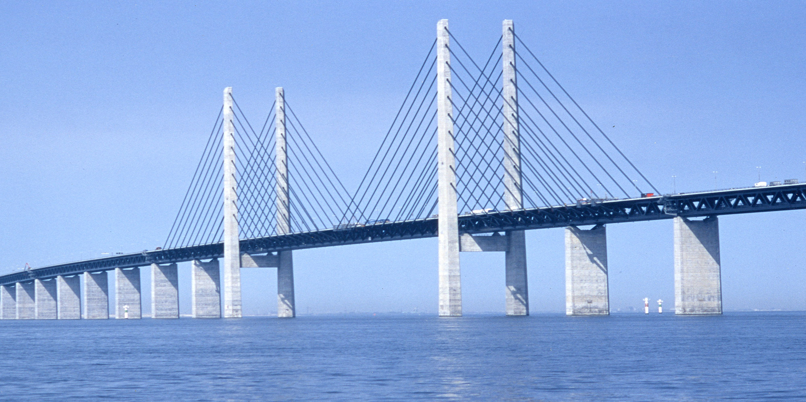
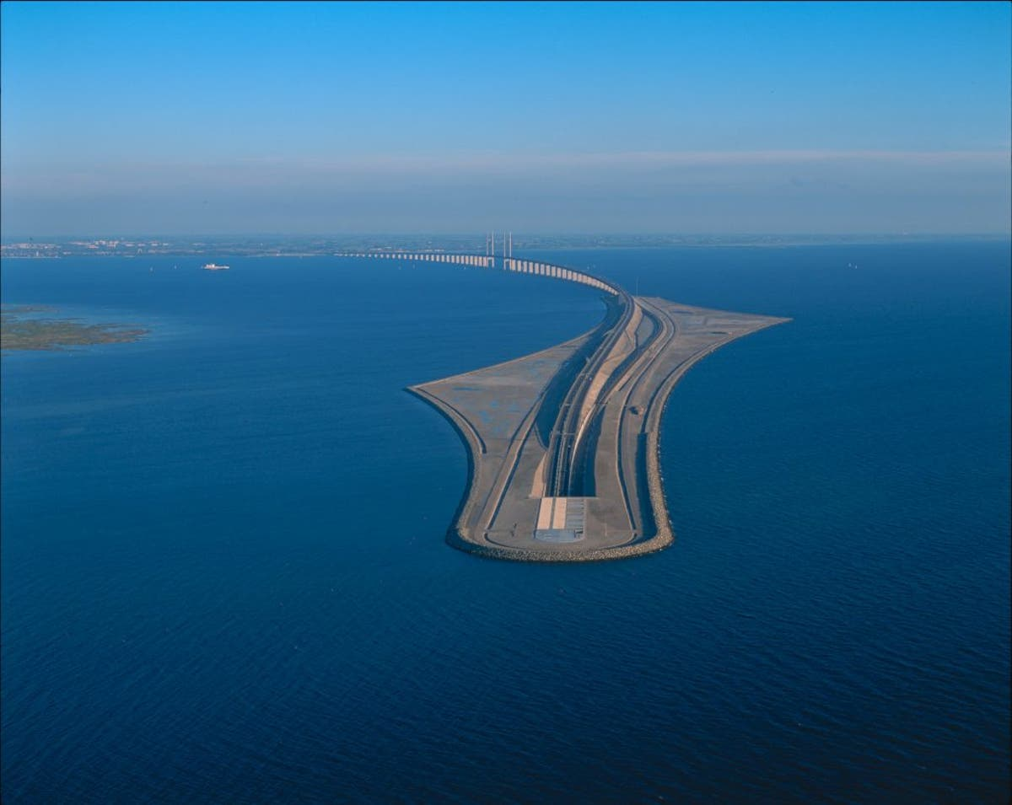
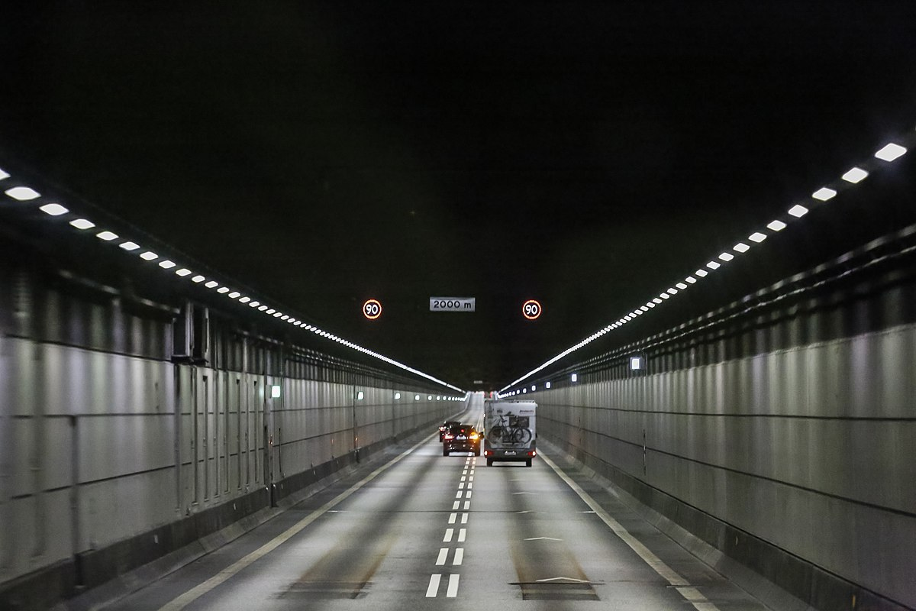
LINK FEATURES
BRIDGE
PEBERHOLM
DROGDEN TUNNEL

Slide 6
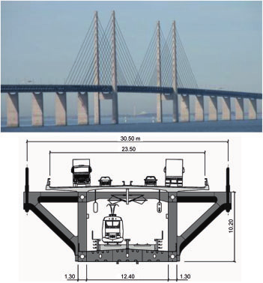
BRIDGE
At 7,845 m, the bridge covers half the distance between Sweden and the Danish island of Amager, the border between the two countries being 5.3 km from the Swedish end. The structure has a mass of 82,000 tonnes and supports two railway tracks beneath four road lanes in a horizontal girder extending along the entire length of the bridge. On both approaches to the three cable-stayed bridge sections, the girder is supported every 140 m by concrete piers. The two pairs of free-standing cable-supporting towers are 204 m high. The cable-stayed main span is 491 m long. A girder and cable-stayed design was chosen to provide the specific rigidity necessary to carry heavy rail traffic, and also to resist large accumulations of ice.
Due to high longitudinal and transverse loads acting over the bridge and to accommodate movements between the superstructure & substructure, it has bearings weighing up to 20 t each. Vibration issues, caused by several cables in the bridge moving under certain wind & temperature conditions, were combatted with the installation of compression spring dampers installed in pairs at the centre of the cables. Two of these dampers were equipped with laser gauges for ongoing monitoring.

Slide 7
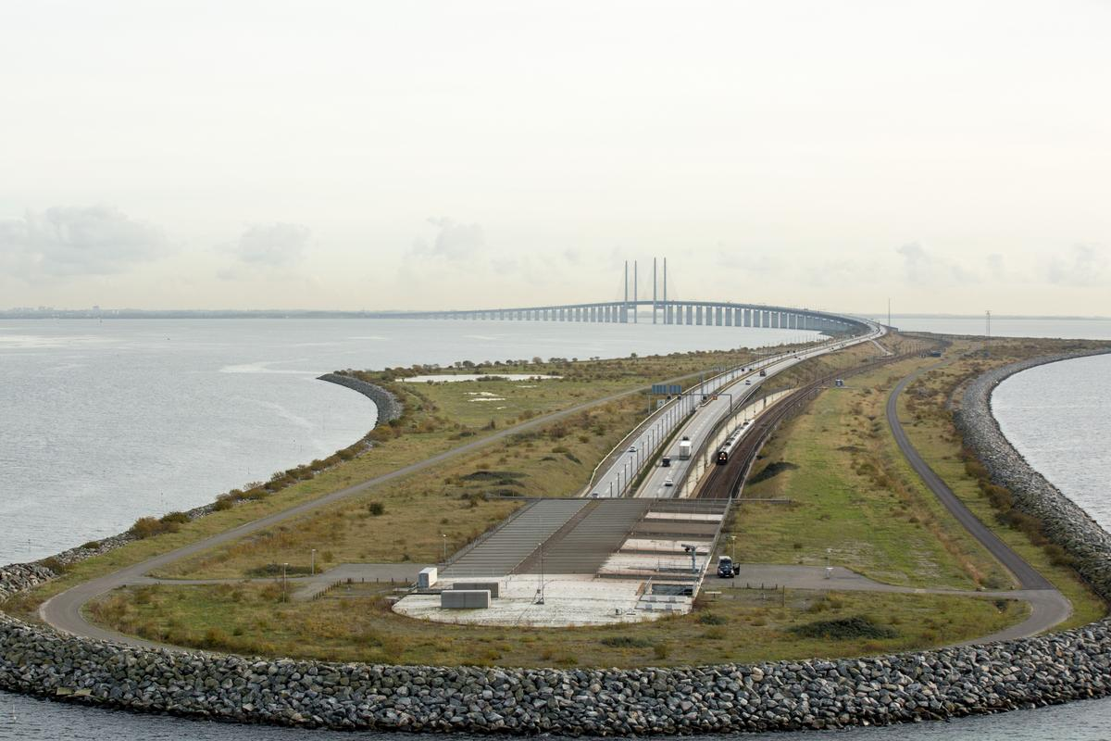
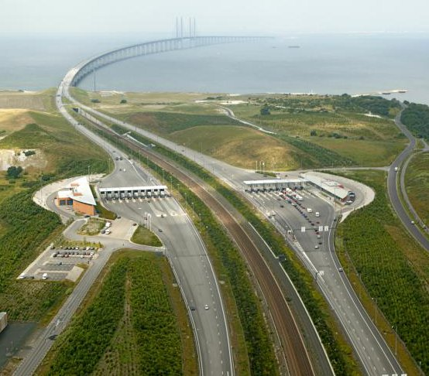
PEBERHOLM ISLAND
The reason for constructing the island was to have a crossover point between the tunnel and the bridge. It is considered to be a biological experiment. Scientists predicted that nature would colonize it and make the island flourish on its own, without any human interaction. As of June 2007, scientists from the Biological Society of Lund had registered 454 species of plants on the island. Also resident to the island as of 2005 were about 20 species of spiders, and approximately 12 species of birds.
The bridge joins Drogden tunnel on the artificial island of Peberholm (Pepper Islet). Peberholm is a designated nature reserve built from Swedish rock and the soil dredged up during the bridge and tunnel construction, approximately 4 km long with an average width of 500m. It is 20 m high.

Slide 8
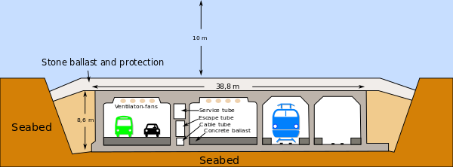
DROGDEN TUNNEL
The connection between Peberholm and the artificial peninsula at Kastrup on Amager island, the nearest populated part of Denmark, is through the 4,050-metre long Drogden Tunnel. It comprises a 3,510-metre immersed tube plus 270-metre entry tunnels at each end. The tube tunnel is made from 20 prefabricated
reinforced concrete segments – the largest in the world at 55,000 tonnes each – interconnected in a trench dug in the seabed.
Two tubes in the tunnel carry railway tracks, two carry roads and a small fifth tube is provided for emergencies. The tubes are arranged side by side. The main purpose of the tunnel is to provide
Transportation between two cities
Combined Road & Rail tunnel

Slide 9
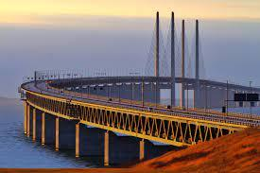
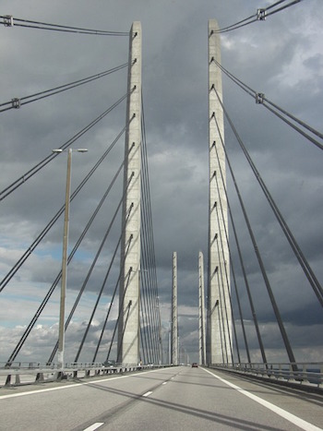
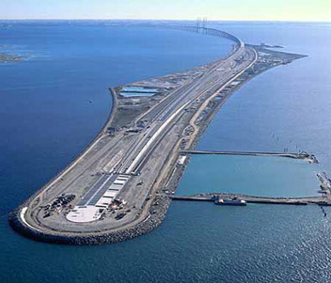
HISTORY
In 1910, proposals were put to the Swedish Parliament for a railway tunnel across the strait, which would have
comprised two tunnelled sections linked by a surface road across the island of Saltholm. The concept of a bridge
over the Øresund was first formally proposed in 1936 by a consortium of engineering firms who proposed a national
motorway network for Denmark.The idea was dropped during World War II, but picked up again thereafter & studied in significant detail in various Danish-Swedish government commissions through the 1950s and 1960s. However, disagreement existed regarding the placement and exact form of the link. Additionally, some regional and local interests argued that other bridge and road projects, notably the then-unbuilt Great Belt Fixed Link, should take priority.

Slide 10
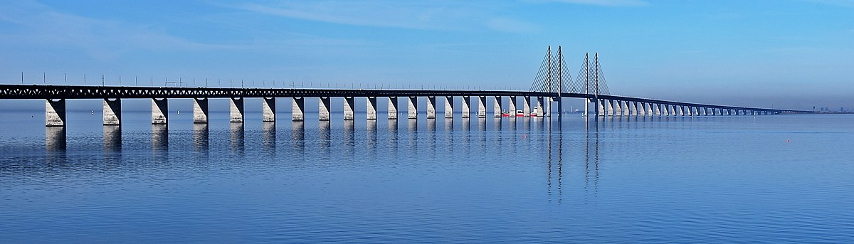
The governments of Denmark and Sweden eventually signed an agreement to build a fixed link in 1973. It would have comprised a bridge between Malmö and Saltholm, with a tunnel linking Saltholm to Copenhagen, and would have been accompanied by a second rail tunnel across the Øresund between Helsingør and Helsingborg.
An OMEGA centre report identified the following as primary motivations for construction of the bridge:
To improve transport links in northern Europe, from Hamburg to Oslo.
Regional development around the Øresund as an answer to the intensifying globalisation process and Sweden's decision to apply for membership of the European Community.
Connecting the two largest cities of the region, which were both experiencing economic difficulties.
Improving communications to Kastrup airport, the main flight transport hub in the region.

Slide 11


ROLE OF ENGINEERS
The 8km-long bridge section of the Øresund fixed link is the world’s longest cable-stayed bridge for combined road and high-speed rail traffic.
The bridge crosses the shipping channel of the Øresund Strait in a 490m-long curving span. Engineers designed the bridge with two side spans of 160m and 141m – one on each side of the main span.
The project team used a composite of steel and concrete for the bridge’s main supporting girder. The concrete top deck of the bridge carries road traffic. The lower deck carries two railway lines.
Each of the bridge’s concrete pylons are 203m high and founded on limestone. Most of the components of the bridge such as the caissons and piers – were prefabricated on-shore and then floated out to the construction site for assembly.
Engineers built artificial islands around and near the bridge to protect against ships hitting the structure.

Slide 12
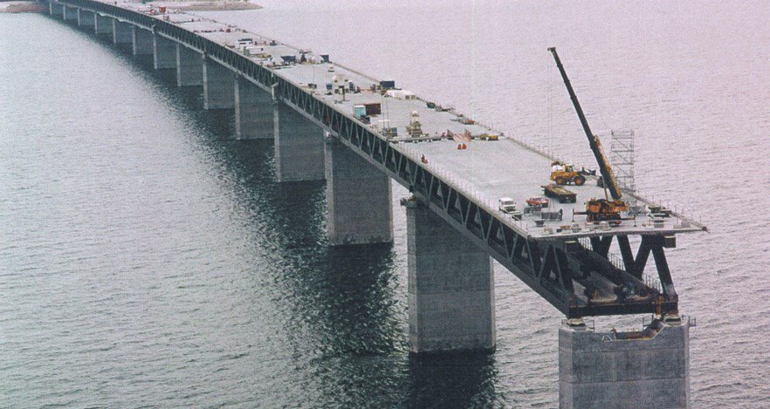
ROLE OF CIVIL ENGINEER
Civil engineers works with other engineering specialists to draw together all of the information they provide to plan and design the overall layout of the bridge and the other structures at the site.
A civil engineer is responsible for checking the strength of the skeleton before concrete is laid down on them to create beams and slabs and columns.
Civil engineers carry out mathematical calculations to model the bridge and the effects of the forces on them. To make sure of its accuracy, they make use of various tools and gadgets.
A civil engineer prepares plans, specifications and cost estimates and during planning and design, will consider what type of bridge will best meet the needs of the area and how the selected building site will support it. They perform load rating and stress analysis calculations to ensure that the structure can stand up to the weight it will bear and the environmental stresses of the site. This engineer also take into account local and regional building codes and requirements.
A civil engineer makes an estimation of the raw materials to be used on site and also communicates with the suppliers to procure the requires raw materials.

Slide 13
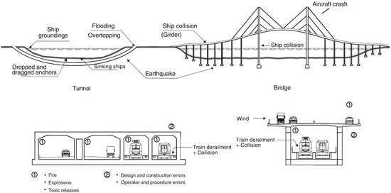

Slide 14
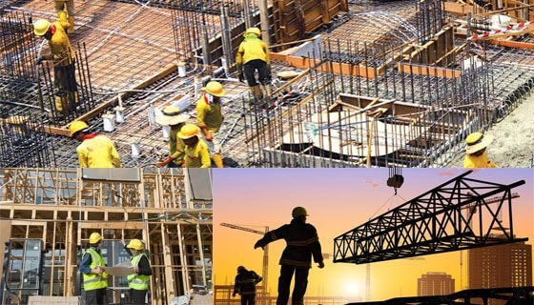
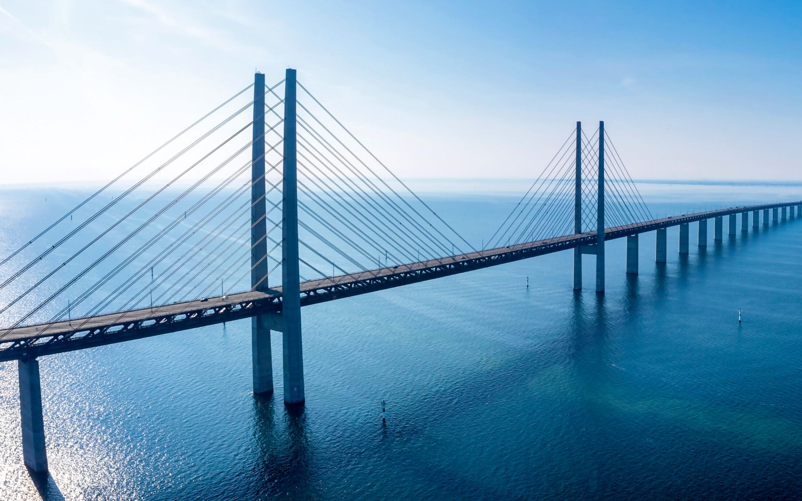
Bridge Engineers are civil engineers responsible for designing and building bridges and other highway related structures. They are often involved with several or all aspects of bridge planning, design and management.
The bridge engineer works closely with other civil engineers who are in charge of the roadway design and alignment.
After the alignment is determined, the bridge engineer often controls the bridge type, aesthetics and technical details.
The bridge engineer is often charged with reviewing drawings and construction details.
The owner, who is often a department of transportation or other public agency, is charged with the management of the bridge.
Bridge management includes routine inspections, repair, rehabilitation and retrofits or even replacement if necessary.
The bridge engineer has significant control over the design, construction, and maintenance processes. They has responsibility for public safety and resources.

Slide 15
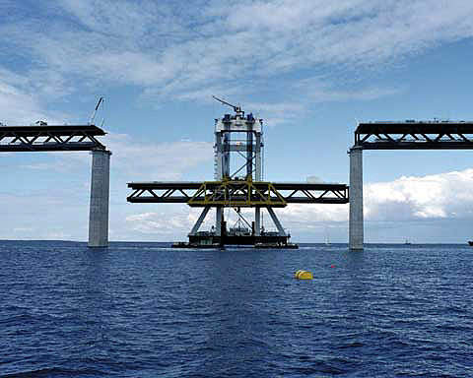
ROLE OF MECHANICAL ENGINEER
Mechanical engineers are responsible for the implementations & moni-toring of all mechanical related operations at the site.
They are responsible for the thorough inspection of the supplied cons-truction materials in addition to selecting the right materials for the construction project. They do a quality check & confirm if the materials are ideal for their needed purposes.
They are responsible for execution and proper installation of respective piping connection and quality analysis of joints.
Mechanical site engineers are responsible for the safety of the workers in the mechanical department during working hours. They are in charge of providing safety wear like helmets & medical aid during emergency.
Mechanical engineers are responsible for breaking down or simplifying construction drawings for fellow engineers and other construction site workers. They also explain safety protocols & how to technically handle the various instruments used on-site to the low-level engineers.
Proper installation, test-running, maintenance, and overall control of all activities related to mechanical equipment and facilities are the duties of mechanical engineers.

Slide 16
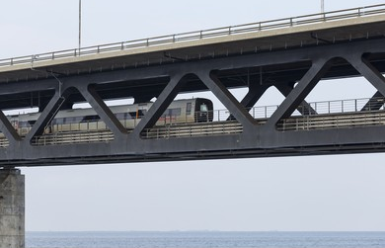
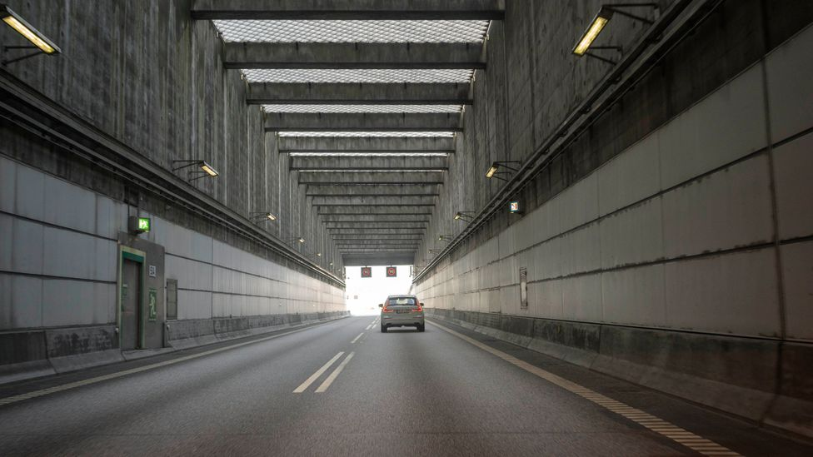
ROLE OF ELECTRICAL ENGINEER
The task of an electrical engineer is to design high voltage equipment such as wiring systems, lighting systems and generators. Within the construction industry, the role of an electrical engineer is to survey the site and manage the esign and construction of electrical systems so that they comply with the necessary codes.
Electrical engineers work with project managers on production efforts to ensure that projects are completed satisfactorily, on time and within budget.
An electrical engineer plan the circuitry and wiring of electronic components. Generally a prototype is built & extensive tests are conducted on it to make sure that it works as designed and that all of the components work well together.
Eletrical engineers plays an important role in the construction of the railway between two countries. The railway between Copenhagen and Malmo was completed on 1st Dec. 1999. The two countries use different electrification and signalling. The railway uses the Danish electrical supply (25kV) over the crossing and switches to the Swedish supply at the east bridgehead. The line follows standard Danish signalling through the tunnel and changes over to the Swedish signalling system on Peberholm. More than 150 trains cross the bridge each day.

Slide 17
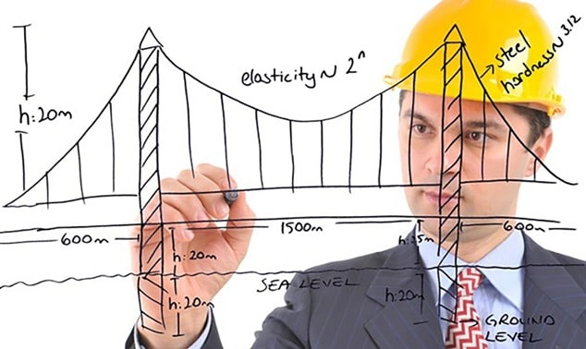
ROLE OF STRUCTURAL
ENGINEER
A structural engineer acts as a consultant to the architect and contractors on site. They are there to make sure all construction works go according to designs. They are also there to solve technical problems & making certain decisions concerning the stability of the structure.
Structural engineers are a key part of the design and construction team, working alongside other engineering disciplines to create all kinds of structures.
Every structure must be built with consideration of the conditions of the its location. Bridges in cold, snowy climates will need to be built with continuous snow and ice loads in mind. Bridges need to carry different kinds of loads, be it people, cars, or high-speed trains. It is a structural engineer’s job to consider all the possible factors, such as dead load (the weight of the structure) and dynamic load (loads that can change or are applied with motion). The structures have to be stiff enough so they do not exceed the vibration limits for which they were designed.

Slide 18
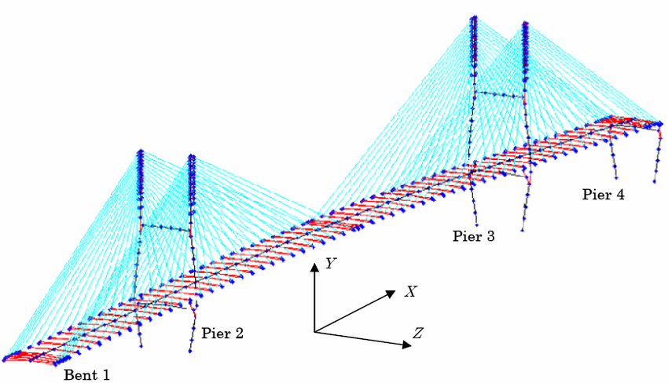
ROLE OF IT ENGINEER
IT Engineers uses CAD systems which are useful for rapid gene- ration of models of proposed designs.
From the dimensions of the given components, the IT engineers were able to calculate the volumes, weights of different materials, centre of gravity, moment of inertia, radii of gyration, stresses on various objects, etc.
With the help of IT sector, several softwares can be used to carry out the surveying works and finalising the site and its alignment with more comfort such as aerial surveys, satellite imageries, etc.
IT systems are used to develop self check tools that can identify problems in various systems and convey prompt reporting of problem and providing rectification.
IT resources helped in understanding of the theory & techniques associated with computer based planning, analysis and control. It helped in practical orientation, construction, project planning, managment and control, time analysis, standard quantitative and qualitative techniques.

Slide 19
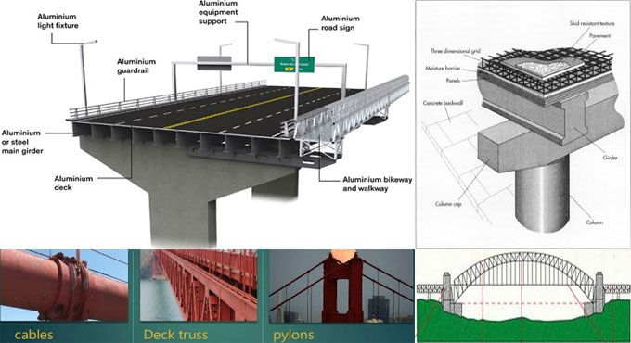
MATERIALS ENGINEERING
Material engineers design, produce and evaluate materials and their use. They understand the properties of matter (both natural and synthetic) and atomic structure.
The materials we use & how we make them can determine the function, feasibility, cost, environmental impact and many other aspects of things we create.
Material engineers are experts on materials—how they are made, how and why materials are useful and how materials can be made better.
When designing structures such as bridges, engineers carefully choose the materials by anticipating the forces the materials (the structural components) are expected to experience during their lifetimes. Usually, ductile materials such as steel, aluminum and other metals are used for components that experience tensile loads. Brittle materials such as concrete, ceramics and glass are used for components that experience compressive loads.

Slide 20
REGIONAL ISSUES
TAXATION POLICIES
ADMINISTRATIVE POLICIES
IMMIGRATION POLICIES
LANGUAGE BARRIERS
DIVERSITY

Slide 21
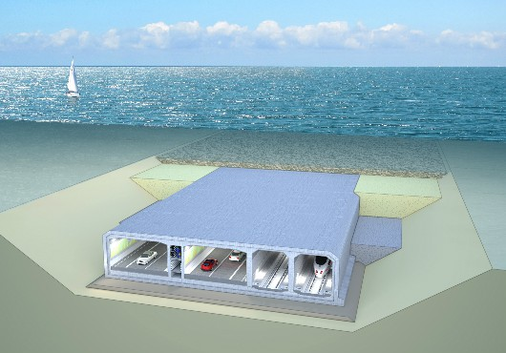
ENVIRONMENTAL ISSUES
The Baltic Sea is the world’s largest body of bracfish with a unique marine ecosystem, which is dependent on the flow of saline and oxygenated water from the North Sea. In 1986, the OD started discussing the effects a fixed link would have on the water flows from the North Sea to the Baltic Sea. This issue became central in
the development of the project & led to major environmental protests. To address the environmental issues, 3–6 m³ of seafloor sediment were dredged to maintain water inflows. Specific care was taken to avoid permanent damage and serious impact on seafloor fauna and flora during the dredging.
PROBLEMS
Building a bridge with hightower’s near the shorline on the Darnish side with the Copenhagen international airport would have obstructed air traffic and could lead to a tragedy.
Building a low bridge would have been safer for air traffic but then it would have blocked Denmark ships.
There were specific demands relating to the monitoring of noise conditions, discharged water from the bridge, discharge of drain water from the tunnel and the calculation of the traffic emissions of greenhouse gases have been drawn up.

Slide 22
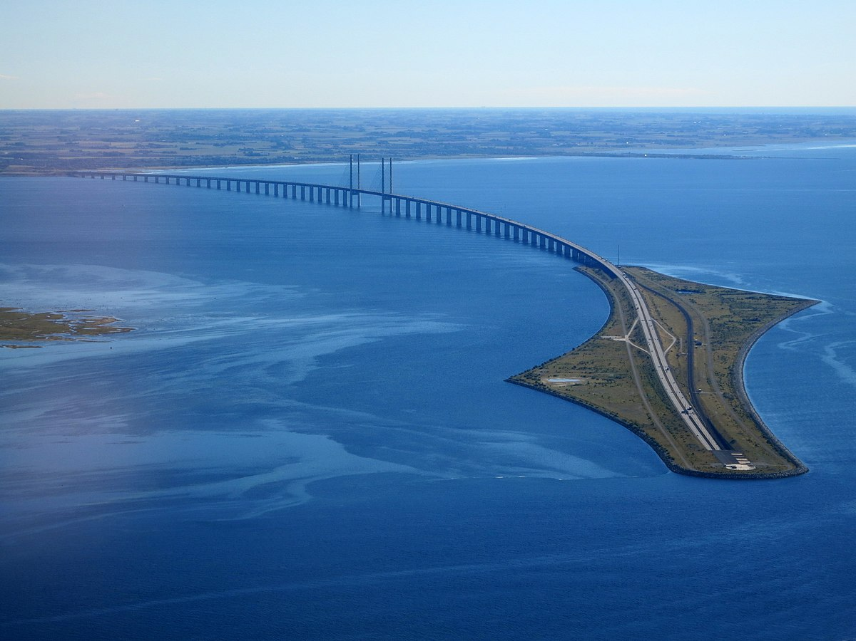
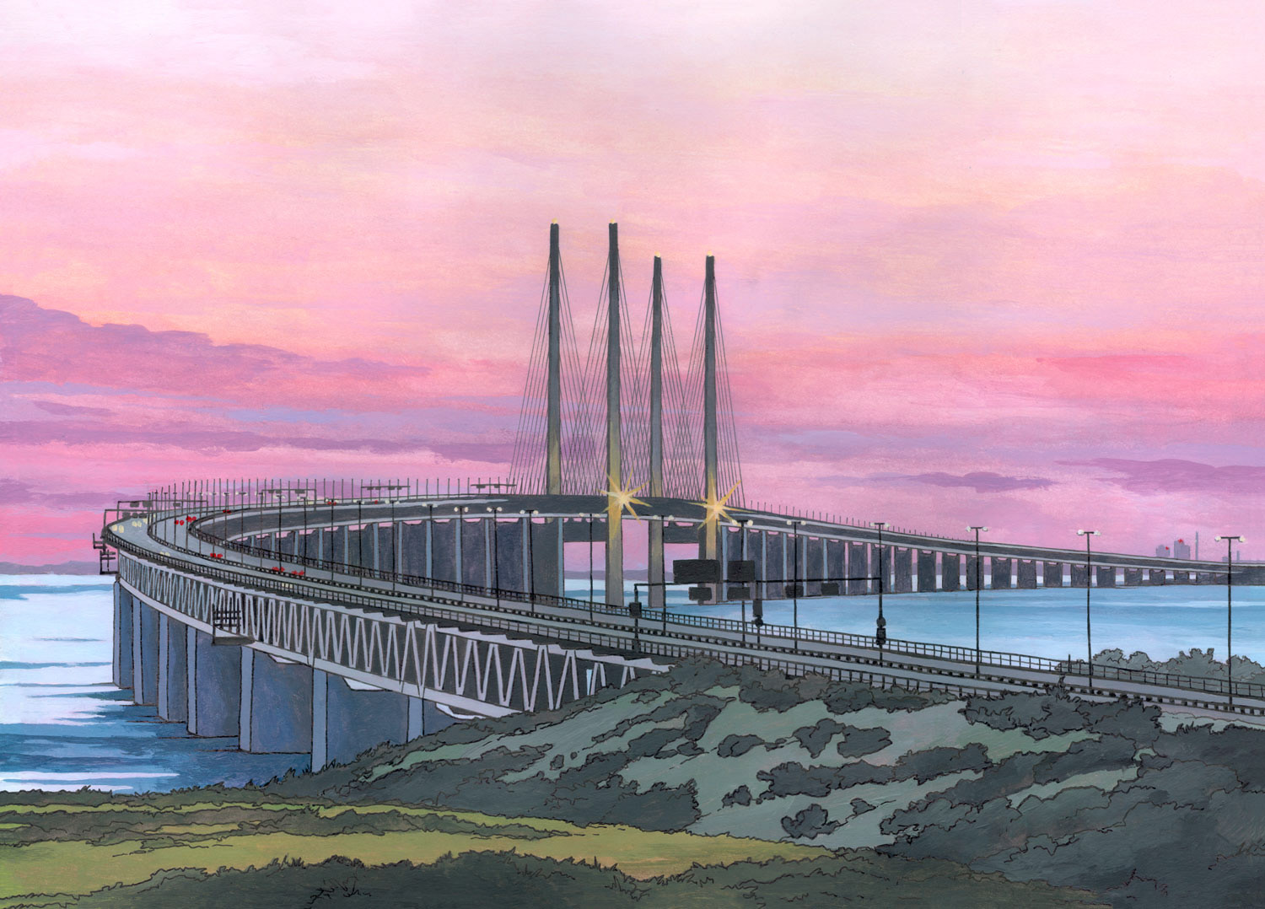

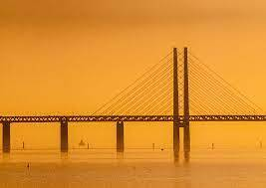
ADVANTAGES OF ORESUND BRIDGE
The Øresund Bridge has resulted in a strong reduction in the emission of greenhouse gases from traffic across Øresund as compared to the ferry services before the link was established.
The bi-national Swedish-Danish region has a long history of cross-border interactions and co-operation. The opening of Oresund bridge between the two countries in 2000 gave a strong boost to the integration process.
Construction of Oresund bridge has increased circular mobility between two regions. It helped to reduce the shortage of labor in Denmark and has boosted the property market in Sweden.

Slide 23


Slide 24

THANK YOU

